Slide 1
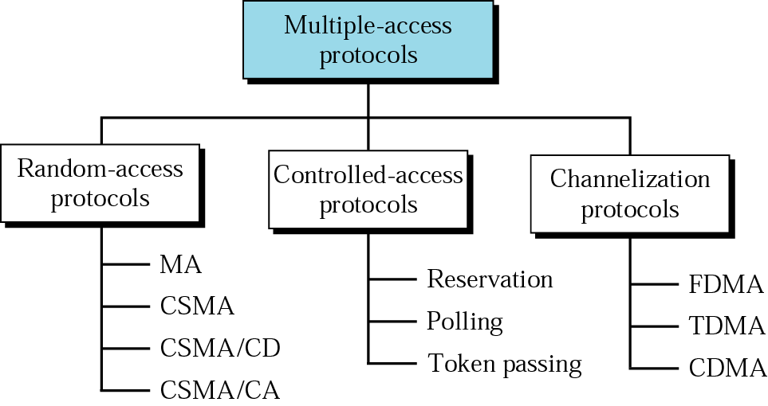
Multiple Access Protocols
ALOHA

Slide 2
RANDOM ACCESS
In random access or contention methods, no station is superior to another station and none is assigned the control over another. No station permits, or does not permit, another station to send. At each instance, a station that has data to send uses a procedure defined by the protocol to make a decision on whether or not to send.
ALOHA
Carrier Sense Multiple Access
Carrier Sense Multiple Access with Collision Detection
Carrier Sense Multiple Access with Collision Avoidance

Slide 3
ALOHA
PURE ALOHA
SLOTTED ALOHA

Slide 4
PURE ALOHA
The idea is that each station sends a frame whenever it has a frame to send
Since there is only one channel to share, there is the possibility of collisions between frames from different stations

Slide 5

Frames in a pure ALOHA network

Slide 6
SLOTTED ALOHA
Because in pure aloha there is no rule that defines when the station can send.
Slotted aloha divide the time into slots of avg transmission time for a frame travel, and force the station to send only at the beginning of the time slot. (reduce collision in this case)

Slide 7

Frames in a slotted ALOHA network

Slide 8

Vulnerable time for slotted ALOHA protocol

Slide 9
Carrier Sense Multiple Access (CSMA)
Better than aloha in term of to minimize the chance of collision occur.
The chance can be reduced if a station senses the medium before trying to use it.
CSMA requires that each station first listen to the medium before sending.
In other words, CSMA is based on the principle “sense before transmit”
CSMA can reduce the chance of collision but impossible to eliminate it.

Slide 10

Space/time model of the collision in CSMA

Slide 11

Vulnerable time in CSMA

Slide 12
Vulnerable time for CSMA
The vulnerable time for CSMA is the propagation time.
This is the time needed for a signal/frame to propagate from one end of the medium to the other.
When a station sends a frame, and any other station tries to send a frame during this time, a collision will occur.
But if the 1st bit of the frame reaches the end of the medium, every station will already have heard the bit and will refrain from sending.

Slide 13
Non-persistent CSMA
What should a station do if the channel is busy? What should a station do if the channel is idle?
While there is a new frame A to send DO
  Check the medium
  If the medium is busy, wait some time, and go to 1.
  (medium idle) Send frame A and wait for ACK
  If after some time ACK is not received (timer times out), wait a random amount of time and go to 1.
End

Slide 14
1-persistent CSMA
While there is a new frame A to send do
  Check the medium
  If the medium is busy, (continue to listen until the channel is sensed idle)go to 1.
  (medium idle) Send frame A and wait for ACK
  If after some time ACK is not received (timer times out), wait a random amount of time and go to 1.
End.

Slide 15
p-Persistent
When channel is idle
  Send with probability p
  Wait and then sense again with probability (1-p)
Sense carrier
Yes
Busy?
Wait
No
r = random( )
No
r < p ?
Yes
Send frame
Notes:
2G1316-17 Datakommunikation och datornät

Slide 16

CSMA with Collision Detection (CSMA/CD)
In the CSMA/CD method, a station monitors the medium after it sends a frame to see of the transmission was a successful. If so, the station is finished. If, however, there is a collision, the frame is sent again.
Collision of the first bit in CSMA/CD

Slide 17
Explanation of CSMA/CD
In the fig, the 1st bits transmitted by the two stations involved in the collision.
Although each station continues to send bits in the frame until it detects the collision, it show what happens as the first bits collide. In fig , station A and C are involved in the collision

Slide 18
At t1, station A starts sending the bits of its frame.
At time t2, station C hasn’t yet sensed the 1st bit sent by A. it then start sending its bits of frame which propagate both to the left and right.
The collision occurs sometime after time t2. station C detects a collision at time t3 when it receives the 1st bit of A’s frame.
Station C immediately abort transmission.
Station A detects collision at time t4 when it receives the 1st bit of C’s frame. It also immediately aborts transmission

Slide 19
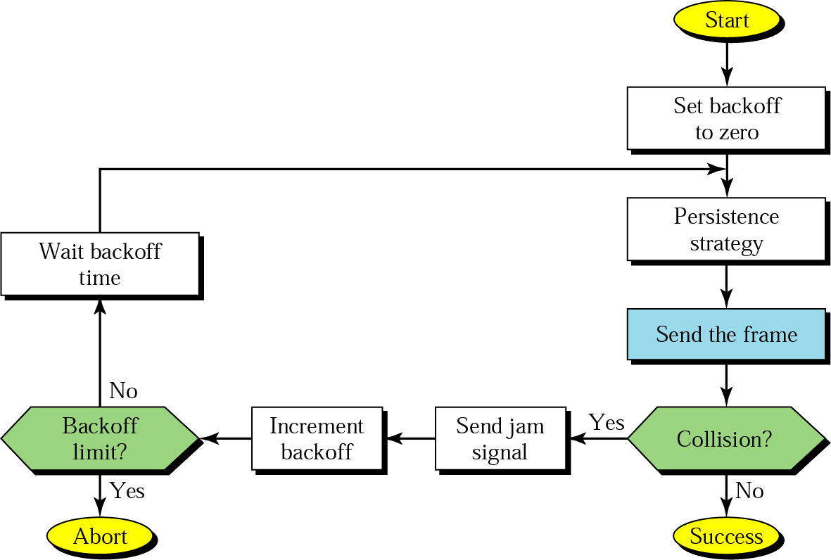
CSMA with Collision Detection (CSMA/CD)
Exponential back-off
  Wait 2^{N} × max_propagation_time after collision, where N is number of transmission attempts
Send jam so other stations detect collision as well
Notes:
2G1316-17 Datakommunikation och datornät

Slide 20
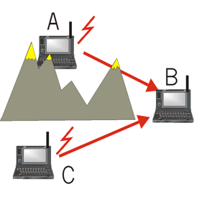
Wireless Networks—Hidden Terminal Problem
A, C cannot hear each other (CS fails)
Collisions at B, undetected (CD also fails)
Obstacles

Slide 21

Exposed Terminal Problem
C wants to send to someone else (not A or B)
A
B
C
B sends to A
C has to wait, since CS signals a medium in use
But A is outside the radio range of C; therefore waiting is not necessary

Slide 22
CSMA/CA
Collision detection does not work well on wireless networks
  Problems with hidden terminals, signal strength differences, etc
CSMA/CA—Carrier Sense Multiple Access with Collision Avoidance
  Control signals before transmission
  Carrier sense:
    do not transmit immediately when medium gets idle (p-persistence)
    Wait random time
      lower collision probability
Use acknowledgements (stop-and-wait)
Notes:
2G1316-17 Datakommunikation och datornät

Slide 23
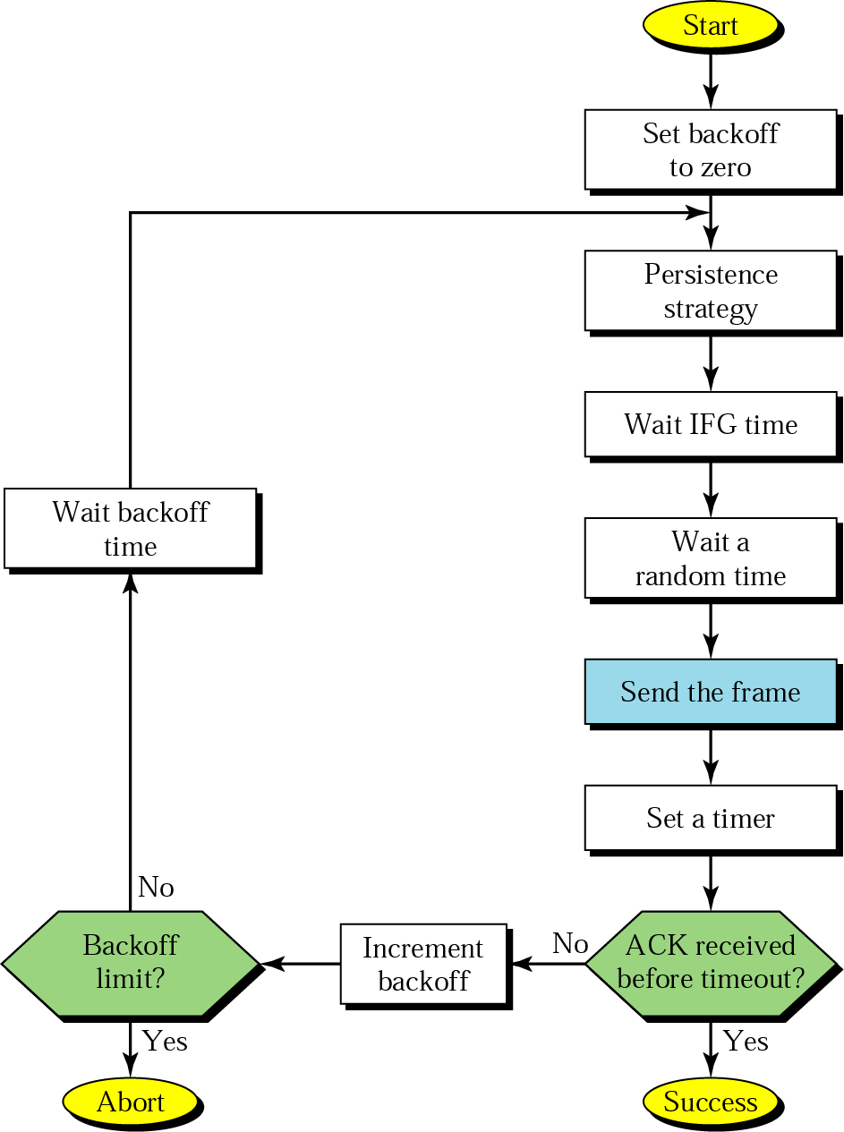
CSMA/CA Procedure
Notes:
2G1316-17 Datakommunikation och datornät

Slide 24

CSMA/CA With RTS/CTS
It uses a three-way handshake protocol
Short signaling packets are used
  RTS (request to send)
    sender request the right to send from a receiver with a short RTS packet before it sends a data packet
  CTS (clear to send)
    receiver grants the right to send as soon as it is ready to receive
The sender then sends the data.
Signaling (RTS/CTS) packets contain
  sender address
  receiver address
  packet size (duration of data transmission)
Notes:
2G1316-17 Datakommunikation och datornät

Slide 25
3-way handshake
RTS
CTS
Data
A
B
Can it solve the hidden terminal problem?
Can it solve the exposed terminal problem?

Slide 26
A Solution: Hidden Terminal
RTS
CTS
CTS
A
B
C
  Both A and C want to send to B
  A sends RTS first
  C waits after receiving CTS from B

Slide 27
A Solution: Exposed Terminal
RTS
RTS
CTS
A
B
C
  B wants to send to A, while C to another terminal
  now C does not have to wait, for it cannot receive CTS from A

